Slide 1
Assignment Task for Seema Analytica
Tanuj Sharma

Slide 2
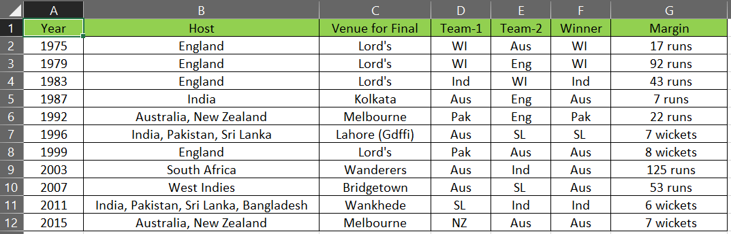
Dataset use for this Task:
The dataset I use for this task is the cricket world cup history.
The data is present in the format of Xlsx.
The dataset is consist of 12 rows and 7 columns.
The snapshot of dataset:

Slide 3
Key Performance indicator
Key indicators displaying a summary of the cricket world cup history results based on various parameters :
Which Country hosted the world cup most?
Which Country had won the most world cup title till now?
Which country had played the most finals?
How many countries had won world cups on their home ground?
Which countries hosted the world cup as a joint?

Slide 4
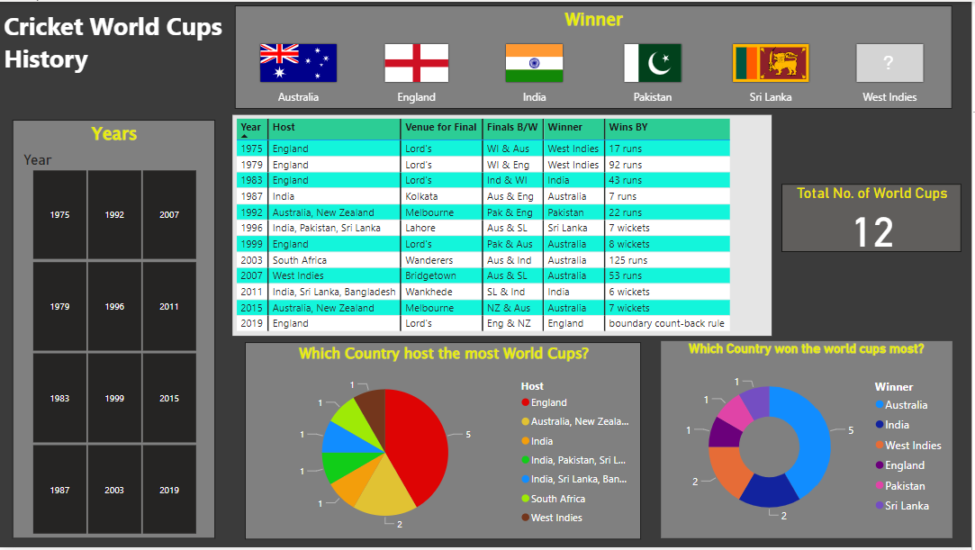
Dashboard

Slide 5
Insights
The first world cups was held in 1975 between Australia and West Indies in Lord’s ground in which West Indies won the match by 17 runs.
Total number of world cup held till now is 12.
England host the 5 world cups till now out of 12, where India and Australia host 2 times and Pakistan, South Africa, New Zealand, West Indies and Sri Lanka host 1 times.
Australia won the 5 world cups till now out of 12, where India and West Indies won 2 times and Pakistan, Sri Lanka, England won the world cup title 1 time.
There is only two countries who won the world cups at their home ground that is India (in 2011) and England(in 2019).
The world cup was jointly hosted by countries: Australia and New Zealand (in 1992 and 2015) India, Pakistan and Sri Lanka (in 1996) India, Sri Lanka and Bangladesh(in 2011)
Australia also played the most finals as compare to other countries.

Slide 6
THANK YOU!

